Slide 1
Yelp Review Analysis
Springboard Data Scientist Career Track Capstone Project 2
Xiangyu Chen, 2018

Slide 2
Why did I choose this data set?
Rich data with detailed user review text and star rating
Extract topics in the reviews
Make better recommendations to different users

Slide 3
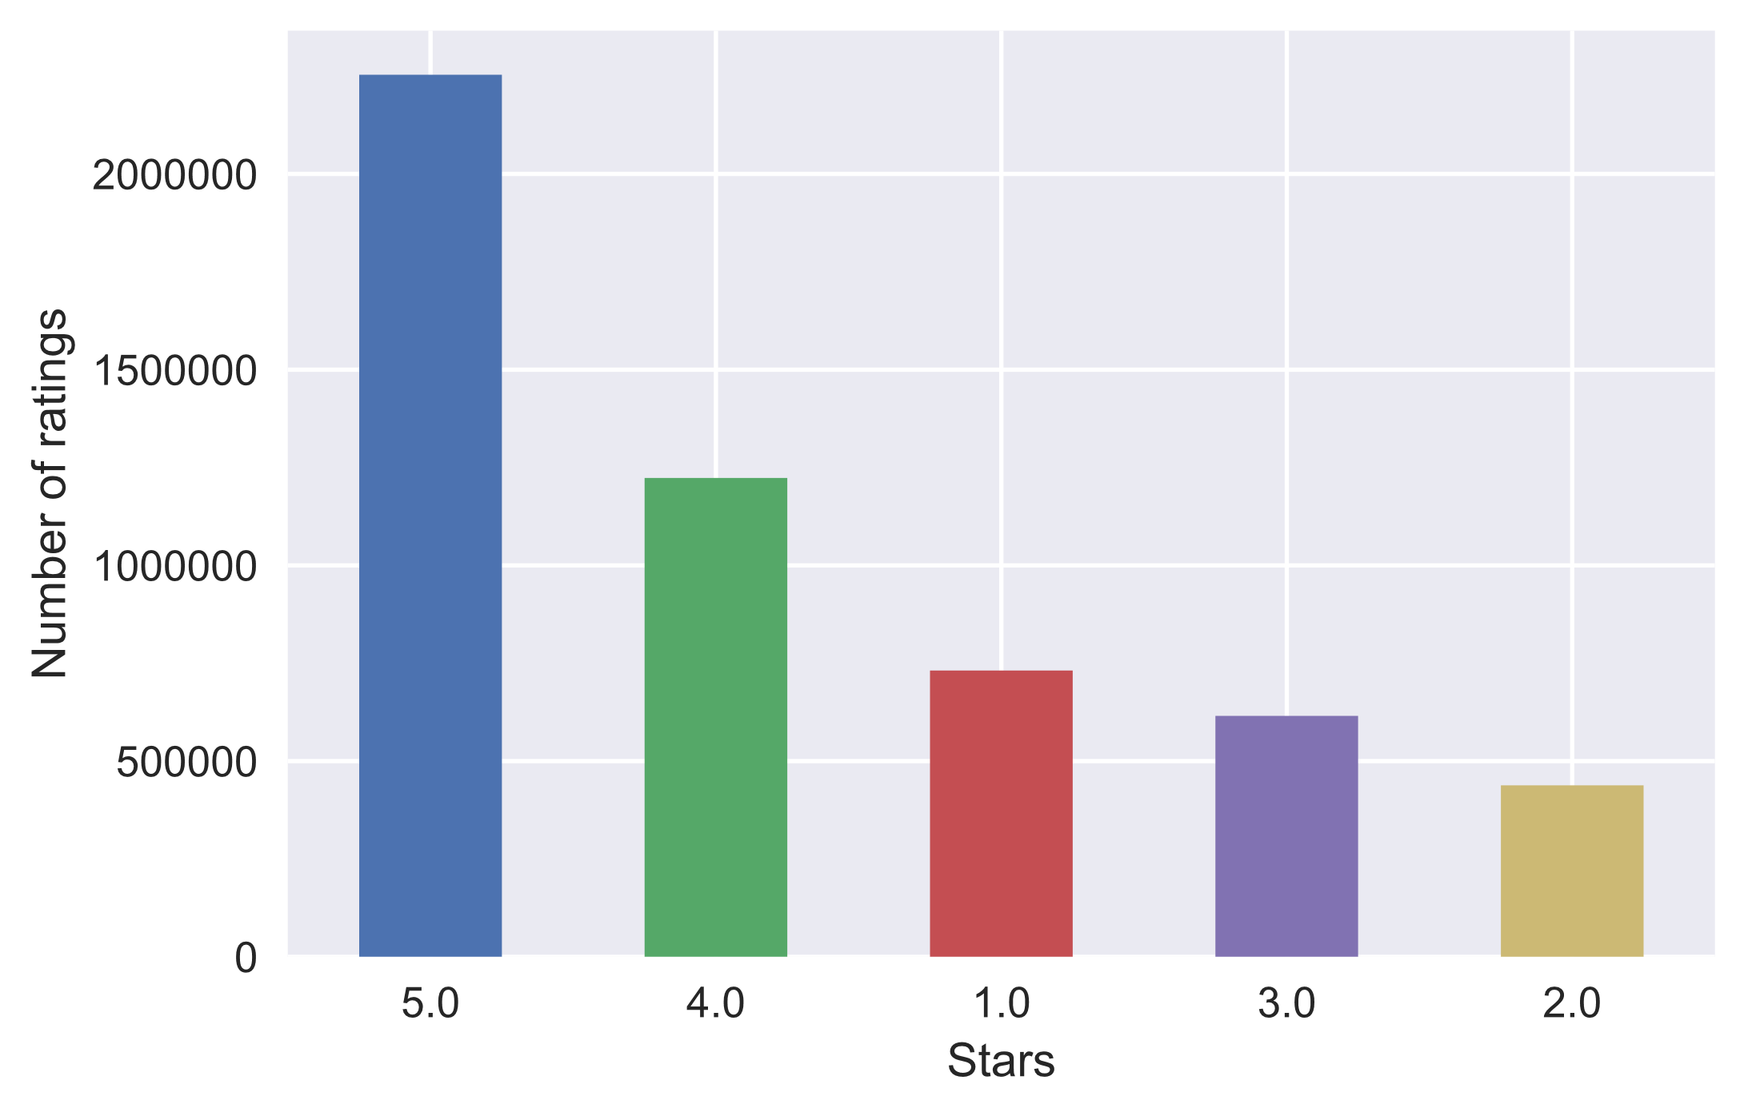
What the review ratings look like

Slide 4
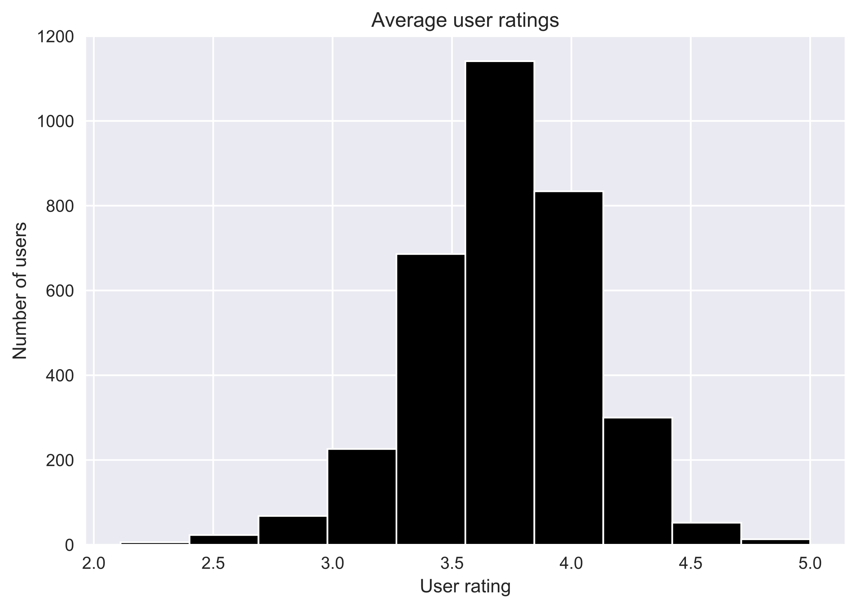
Average star ratings for all businesses

Slide 5
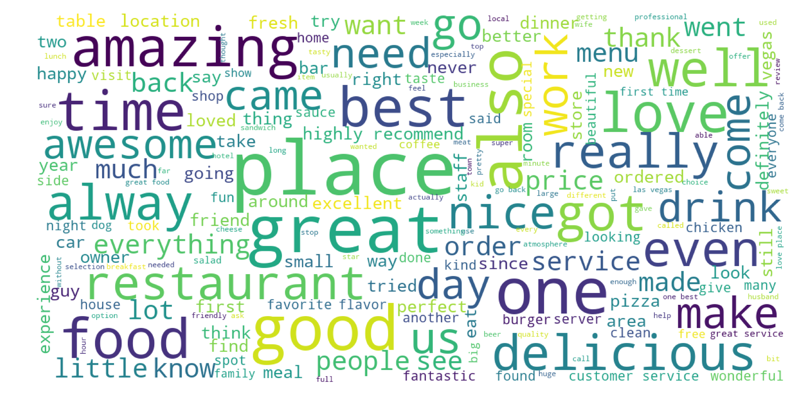
What are the most frequent words in reviews for good restaurants?

Slide 6
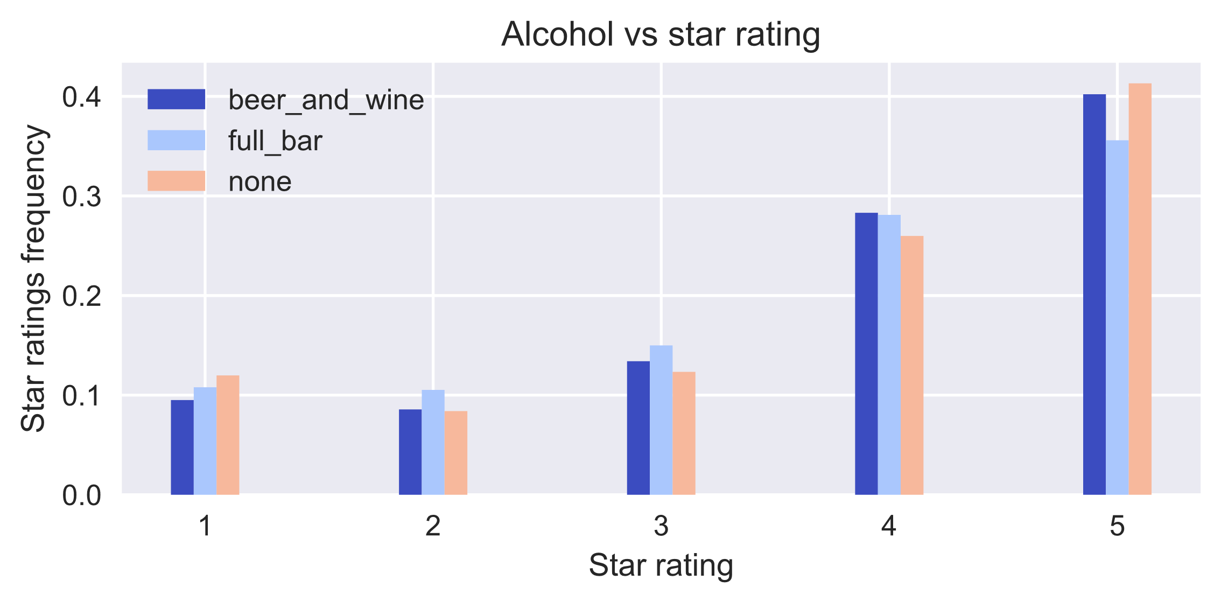
Restaurant attributes that affect star ratings

Slide 7
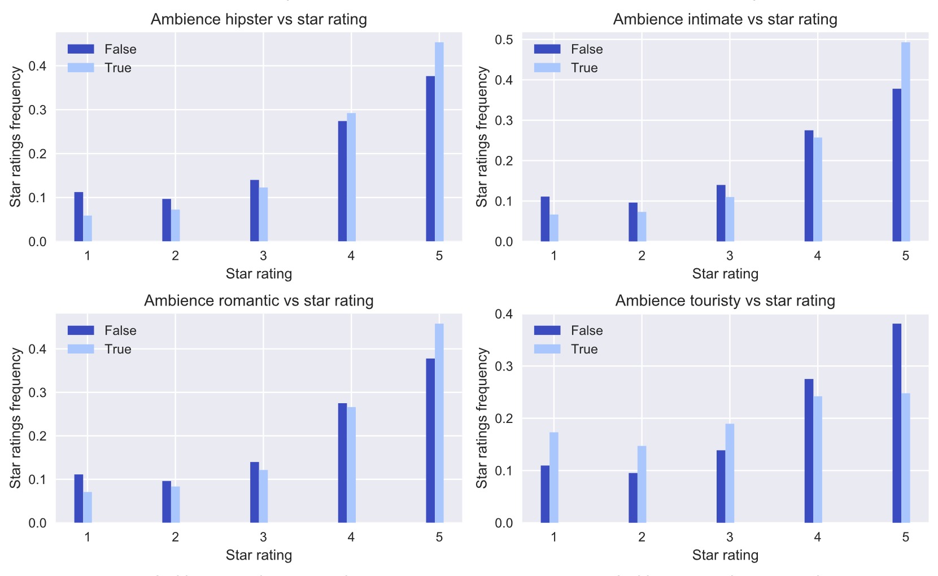
More restaurant attributes

Slide 8
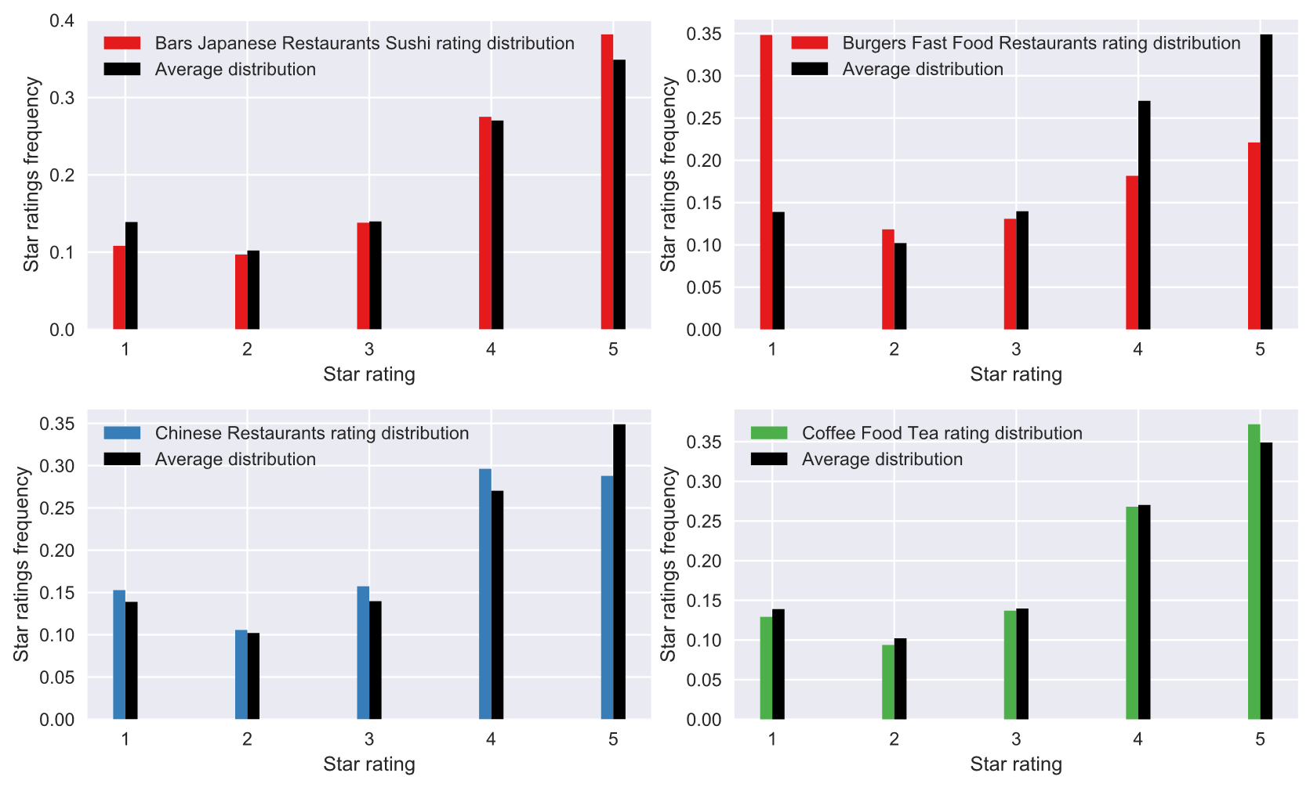
Do types of restaurants affect star rating?

Slide 9
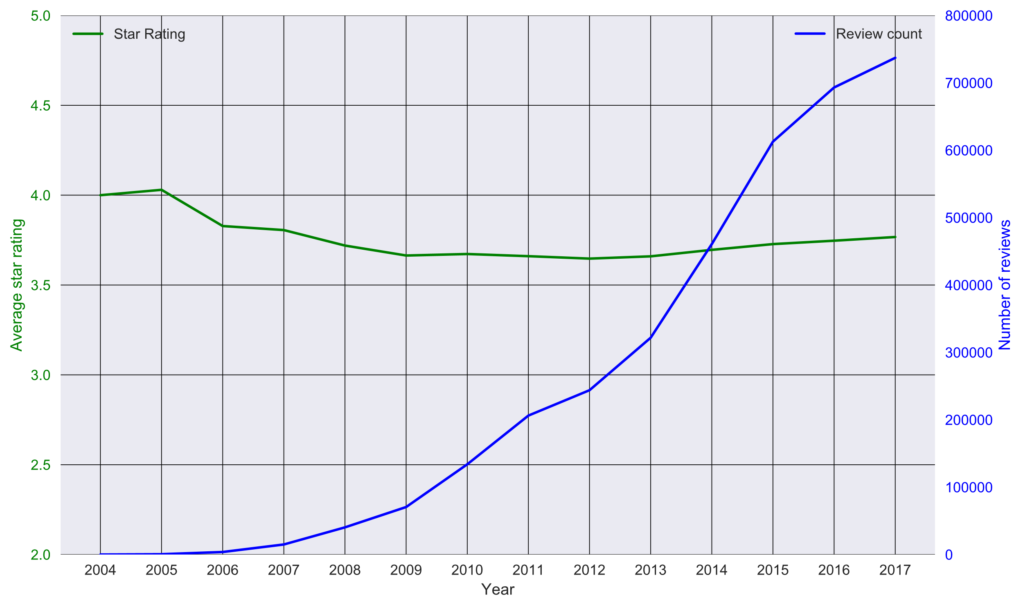
Average ratings change over time

Slide 10
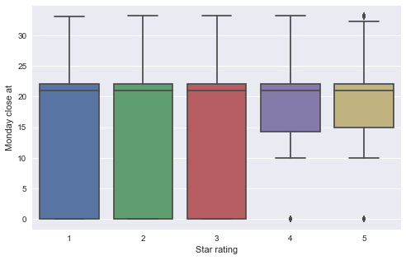
Restaurants closing times also impact star ratings

Slide 11
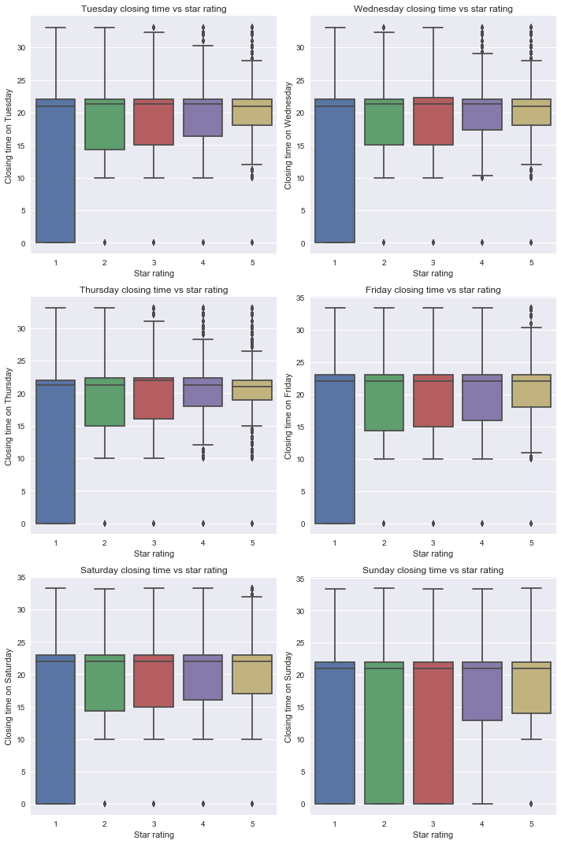
Restaurants closing times for all days of the week

Slide 12
Continue closing times during the week

Slide 13
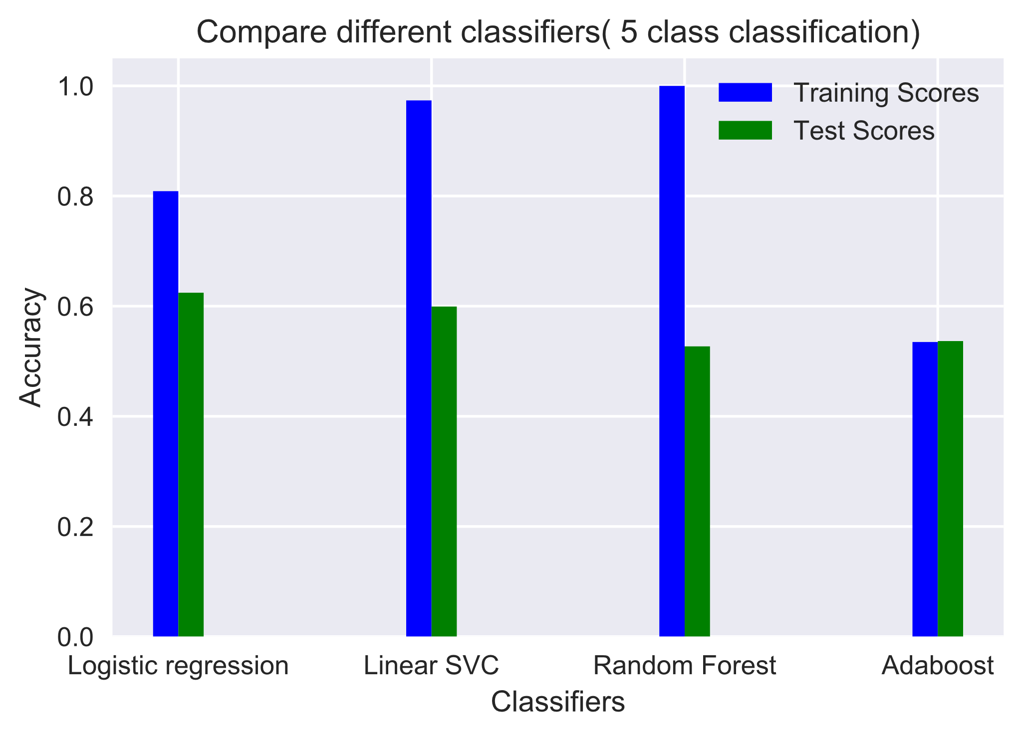
Predicting 5 different classes (star rating from 1 to 5)

Slide 14
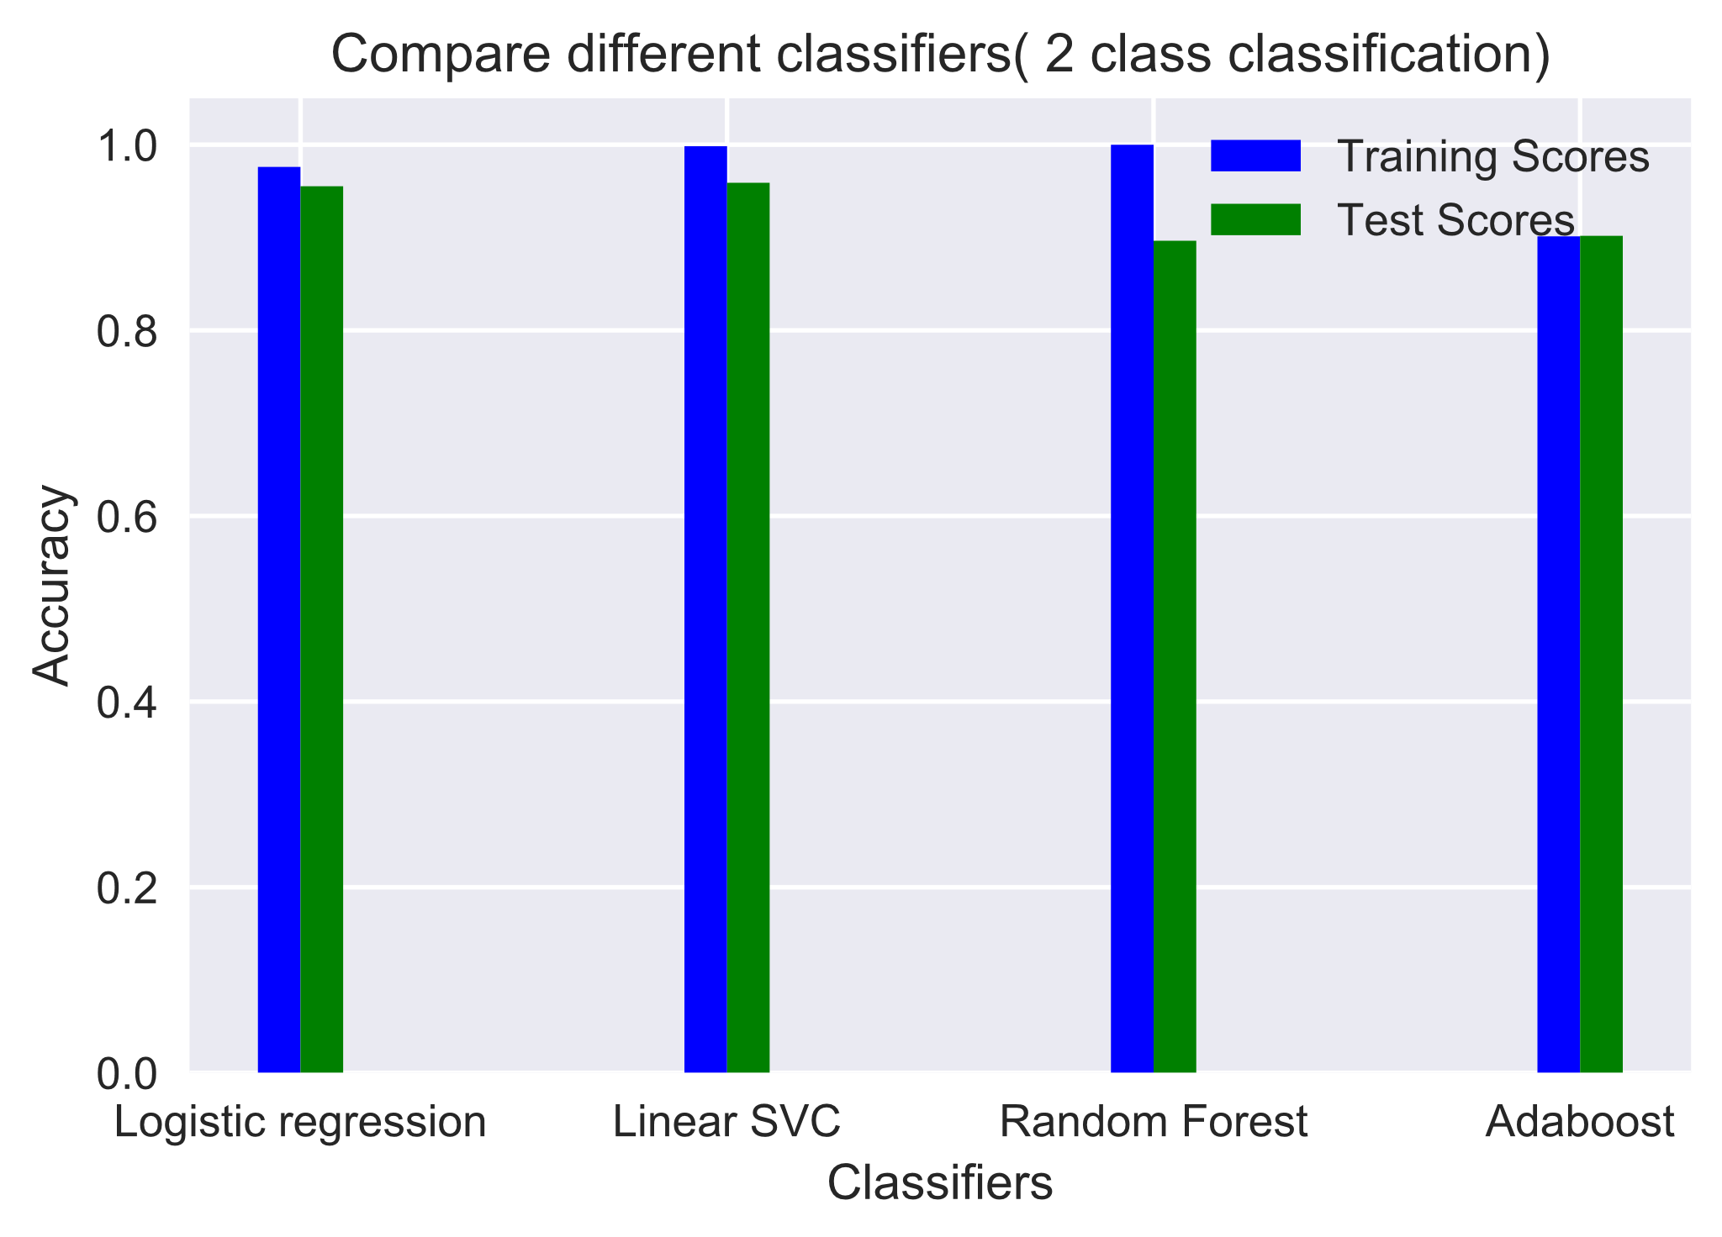
Predicting 2 different classes (grouping 1 and 2 stars and 4 and 5 stars)

Slide 15
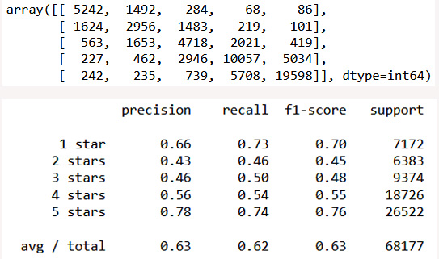
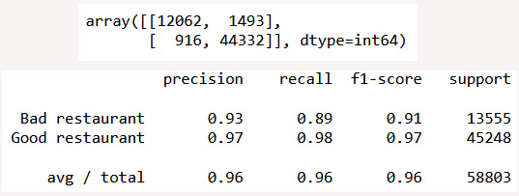
Comparing confusion matrix and f1 scores
5 class prediction
2 class prediction

Slide 16
Cross validation of the models

Slide 17
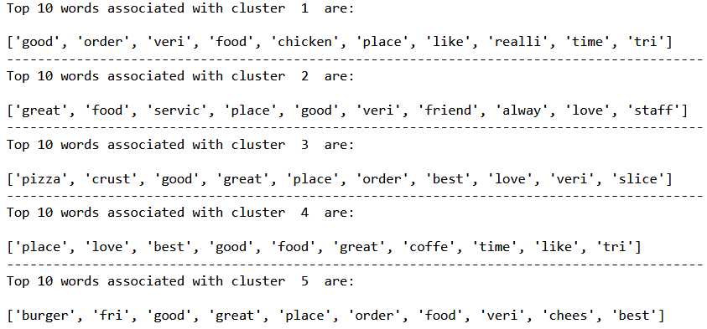
Clustering of all the user reviews
Good chicken food
Great service, good staff
Great pizza place
Best coffee shop
Good cheese burger
Top tokens in each cluster
Topics I summarized

Slide 18
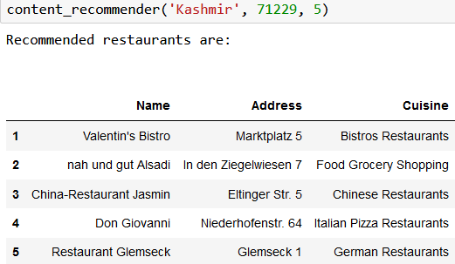
Making recommendations: adjusted ranking based

Slide 19
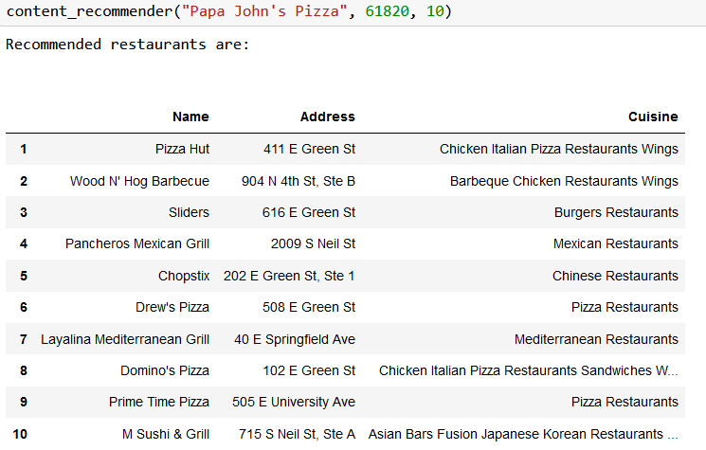
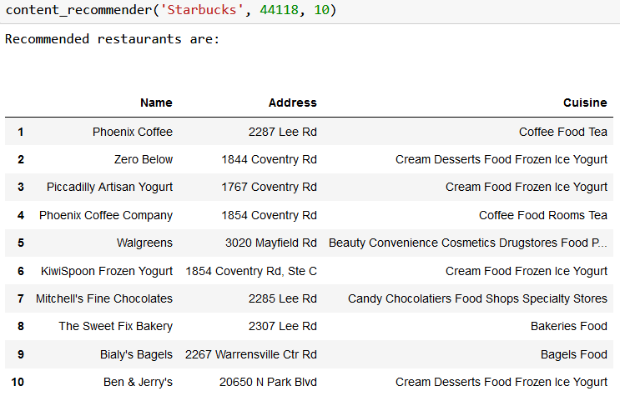
Making recommendations: content-based

Slide 20
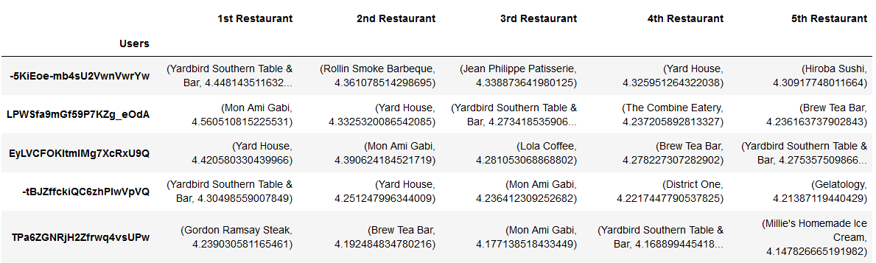
Making recommendations: collaborative filtering

Slide 21
Discussion
The star rating prediction model did not generate a very good score when predicting the 5 classes. This could be due to: not enough data trained; class imbalance; feature selection; parameter tuning/cross validation.
Due to time and resources limitation, the whole data set was not used in the prediction model but rather a subset of the data was used. This could contribute to the sub-optimal score obtained.
There were many missing values for a lot of the categorical features which were impossible to impute from the data set and I had to drop those features. The loss of the information could contribute to the less optimal performance of the model.
Typos and misspelled words in the review text could contribute to data inaccuracy when they were transformed by tfidf vectorizer to generate text features.
For clustering, there were no effective way to evaluate the model rather than inspect by eye.

Slide 22
Future work
To use cloud computing to utilize all the data for the star rating predictions and see if that would improve the scores. Also, try more complex neural network/deep learning.
Compare feature importances using Random Forest and Logistic Regression and check if they agree with each other.
For the 5-class prediction, try down sampling of the over-represented classes to make all classes equal and see if that would increase the scores.
For text features, try doing tri-grams to see if that would capture more trends such as negations in the text.
For year of ratings, maybe don’t use scaling as when new data come in, the max of years will also change.

